Slide 1

Care4Alf 10 years of experience in one tool
Willem Van den Eynde,
Thomas Straetmans

Slide 2

Since Jan 2014
133 Willem Van den Eynde 63 Laurent Van der Linden 34 Thomas Straetmans 12 Giovanni Boscarino 10 Michiel Huygen 10 Younes Regaieg 6 Stan Mine 4 raven 4 Bkevin 3 Thijs Lemmens
3 years
~30 fix scripts
600k lines of code

Slide 3

What? Why? How?

Slide 4
Philosophy
“Better to put our knowledge in tools and scripts rather then keep them in the minds of our developers or on some long forgotten documents.”
“Why write a script over and over for different clients and different cases, if you could just write it once, add to Care4Alf and use that in all cases?”

Slide 5
Functionalities
Bulk
Document models
Browser
Logging
Category Installer
Monitoring
SQL
SSO
SolrAdmin
Dictionary
Tail

Slide 6
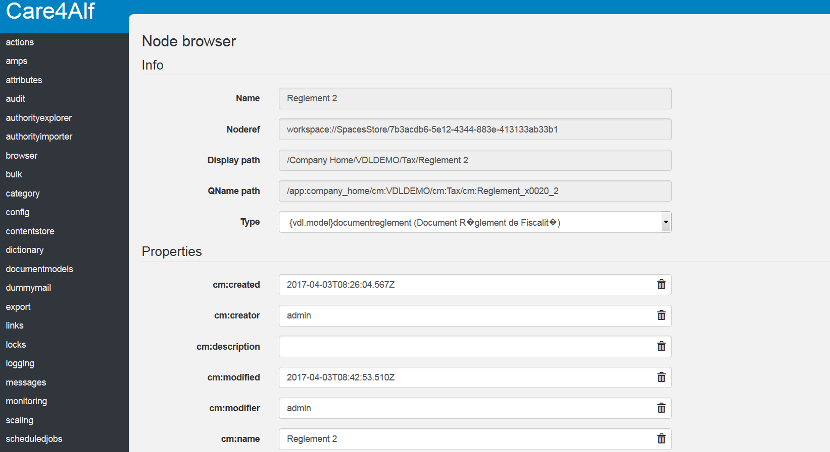

Slide 7
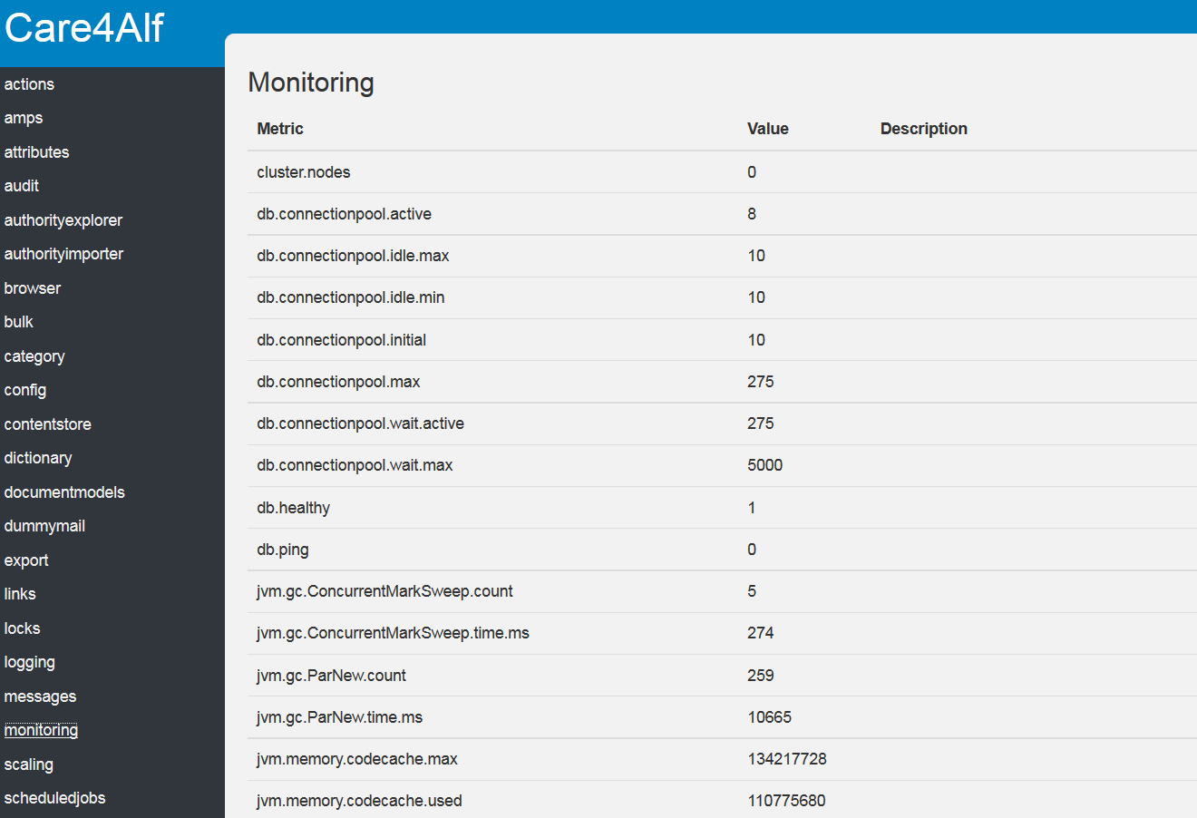

Slide 8
Case for developers
Health-check after redeploy
Quick access to formatted error log without having to access the server
Change logging settings on the fly
Easy way to run specific fixes
Fast creation of test data

Slide 9
Testimonials
….

Slide 10
Demo

Slide 11
Installation

Slide 12
Requirements
Dynamic-Extensions Amp https://github.com/laurentvdl/dynamic-extensions-for-alfresco
Care4Alf Amp or Jar
https://bitbucket.org/xenit/care4alf

Slide 13
Installation
Install DE amp
Install Care4Alf Jar via DE or install the amp
Browse to /alfresco/s/xenit/care4alf/

Slide 14
Questions?

Slide 15
Speaker contacts
Willem Van den Eynde
willem.vandeneynde@xenit.eu
Twitter
…..
Thomas Straetmans
thomas.straetmans@xenit.eu

